Slide 1
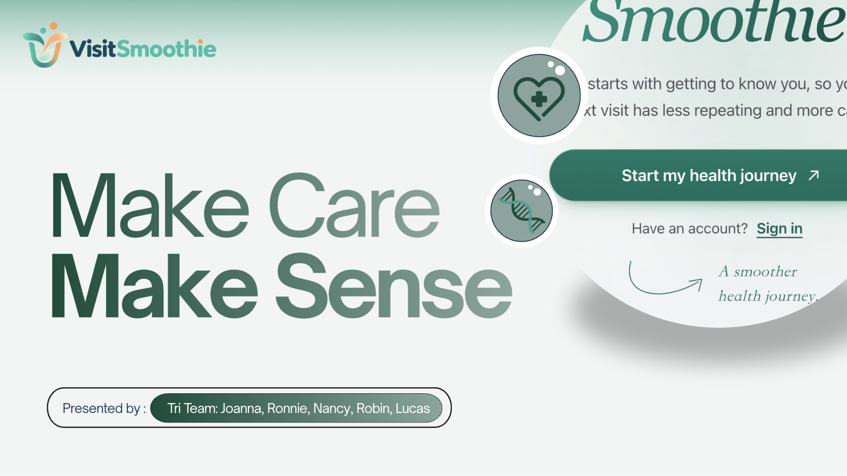
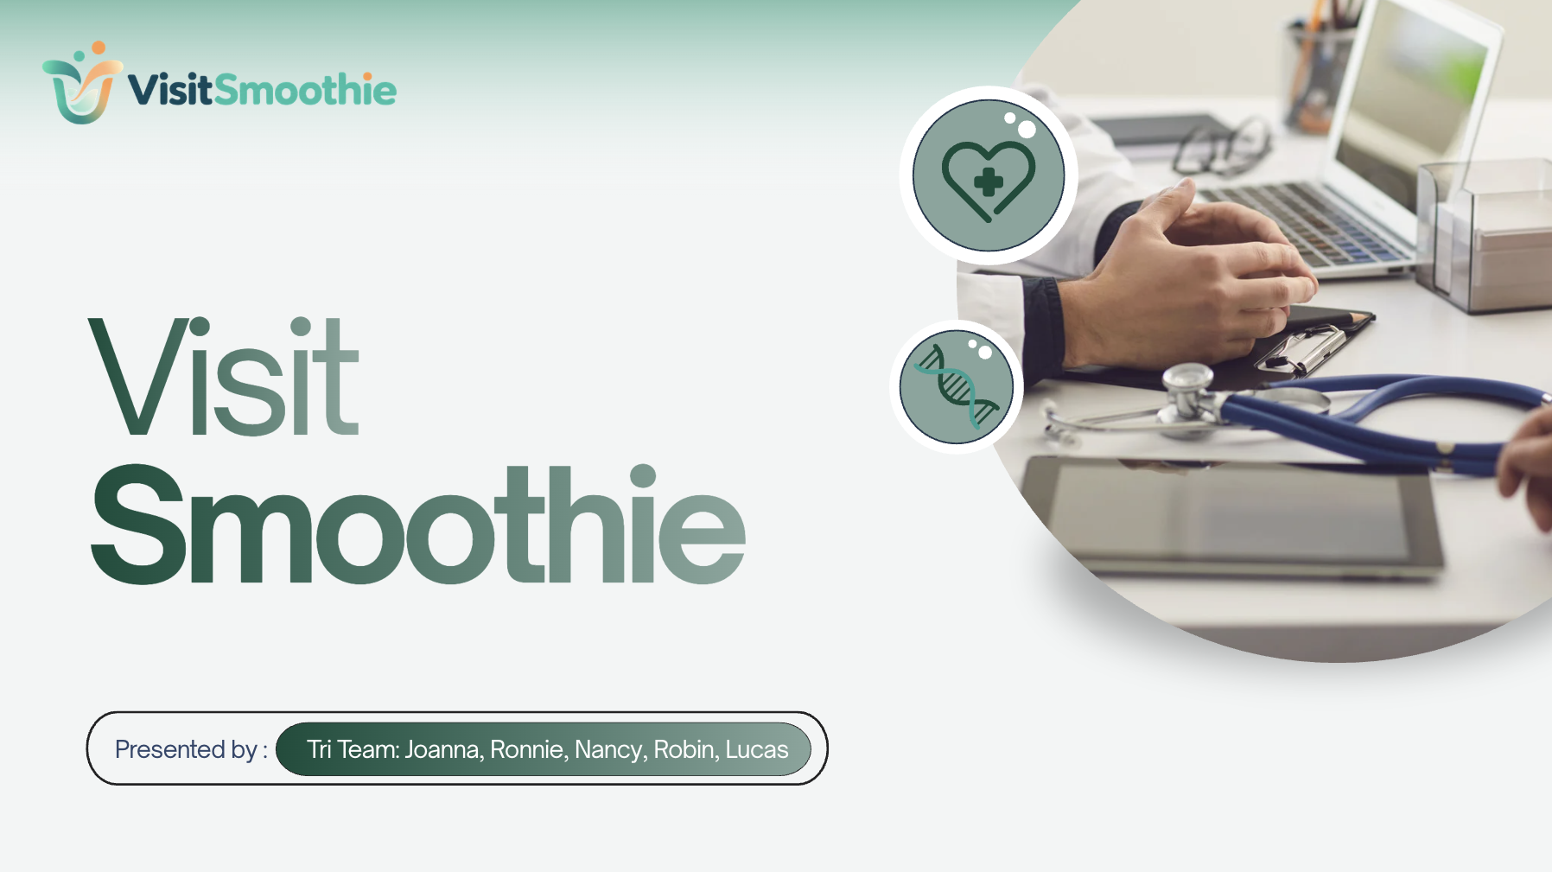
Notes:
Hi everyone, we’re VisitSmoothie. We’re here to make outpatient care smoother.
Imagine walking into an outpatient clinic knowing your body is uncomfort—but struggling to explain it clearly.
The doctor asks, “What’s going on?” but the clock is already ticking. There isn’t enough time to slowly reconstruct when it started or what medicine you’ve taken.
A few minutes later, the visit is over. You leave with a prescription, a test order, and several instructions. But on the way home, new questions appear: What exactly am I supposed to do? When should I come back? And why was my treatment designed this way?
And this actually happens at scale.

Slide 2
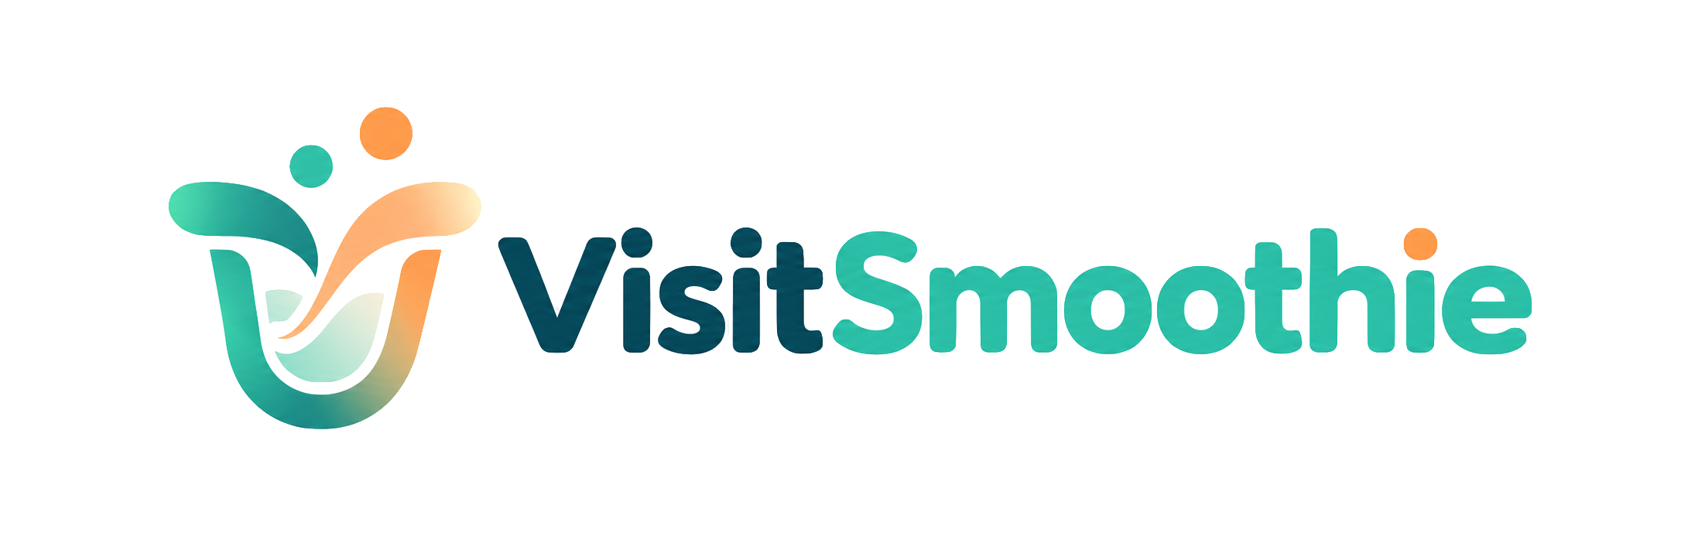
Problem: The Visit Is Short. The Information Isn’t.
10.1 billion
~3 min
11,959 outpatients
healthcare visits in China in 2024, national statistics
average consultation after ~40 min of waiting, in a study of one large Chinese hospital
communication & time with doctors shape satisfaction
Notes:
China handled more than 10 billion medical visits in 2024. In one large tertiary hospital, patients waited roughly 40 minutes for a consultation that lasted only around three minutes. And across a national survey of nearly 12,000 outpatients, communication with doctors and time spent with doctors were both important drivers of patient satisfaction.
So the problem is that both patient and doctor sides are trying to exchange complex information inside an extremely compressed interaction.

Slide 3

What Patients Struggle With Before and After the Visit
BEFORE THE VISIT
AFTER THE VISIT
“History-taking takes time. In short outpatient visits, important details, such as symptom progression, medications, exposure history, and family history, can be missed.”
“I had the prescription, but I still wanted to know why this medication was chosen, why I needed it for this long, what risks I should watch for, and what the test was for.”
Nurse + patient perspective, translated and condensed from interview notes
Patient with a chronic condition · translated
Before the visit, the full story is hard to pass on. After it, the plan is hard to understand. A few minutes leaves little room for either.
Notes:
And our interviews showed us what that looks like in real life.
Before the visit, a participant told us that history-taking itself takes time, and important information can be missed.
After the visit, a chronic-care patient told us that even with a prescription in hand, she still wanted to understand why that medication was chosen, why she needed it for that long, what risks to watch for.
So the information gap happens on both sides of the visit. Important patient information struggles to get in, and important clinical information struggles to come back out clearly. Therefore, adult outpatients in China visiting public hospitals need a way to give the doctor their complete story before the visit, and to understand and act on the plan after it
because a visit of a few minutes leaves little room to explain fully or to ask.

Slide 4
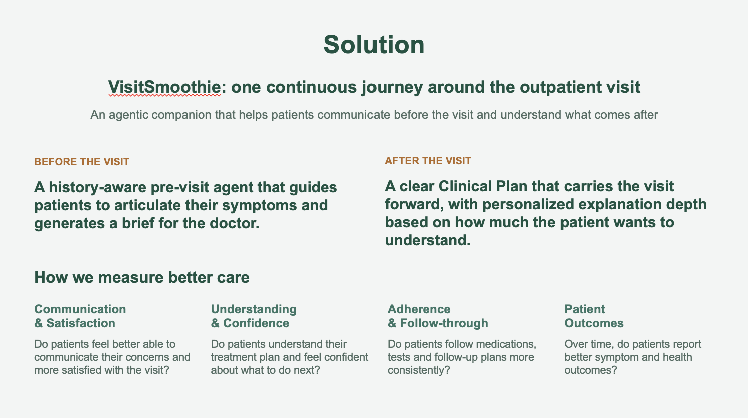





Two jobs, one record: prepare the story, follow the plan
BEFORE THE DOCTOR
THE VISIT
AFTER THE DOCTOR
AT HOME
Give the full story
No AI in the room
Make the plan usable
Follow it and check in
Body map, typing, voice or a photo. The agent asks one missing item at a time.
The patient shows the page. The doctor decides.
Record the visit or photograph the record or prescription.
Reminders from the lines you chose. “Better / same / worse” check-ins.
→ A page for the doctor, plus a rule-based urgency and department hint
→ A Clinical Plan: diagnosis, medicines, to-dos, cautions, follow-up. Tap any line to ask.
→ Ask questions about your own record
Every saved visit becomes memory. At the follow-up, Before the doctor starts from the last saved plan, medicines and profile.
Notes:
VisitSmoothie is an agentic outpatient companion that helps patients articulate their symptoms before the visit and make sense of what comes after. Before the appointment, it uses the patient’s history and current symptoms to ask only the missing questions and generate a patient-reviewed brief for the doctor. Afterward, it turns prescription and visit audio into a clear Clinical Plan, answers questions within safe boundaries, and carries the visit forward through reminders and longitudinal records.
How we measure better care
Communication & Satisfaction Do patients feel better able to communicate their concerns and more satisfied with the visit?
Understanding & Confidence Do patients understand their treatment plan and feel confident about what to do next?
Adherence & Follow-through Do patients follow medications, tests, and follow-up plans more consistently?
Patient Outcomes Over time, do patients report better symptom and health outcomes?

Slide 5
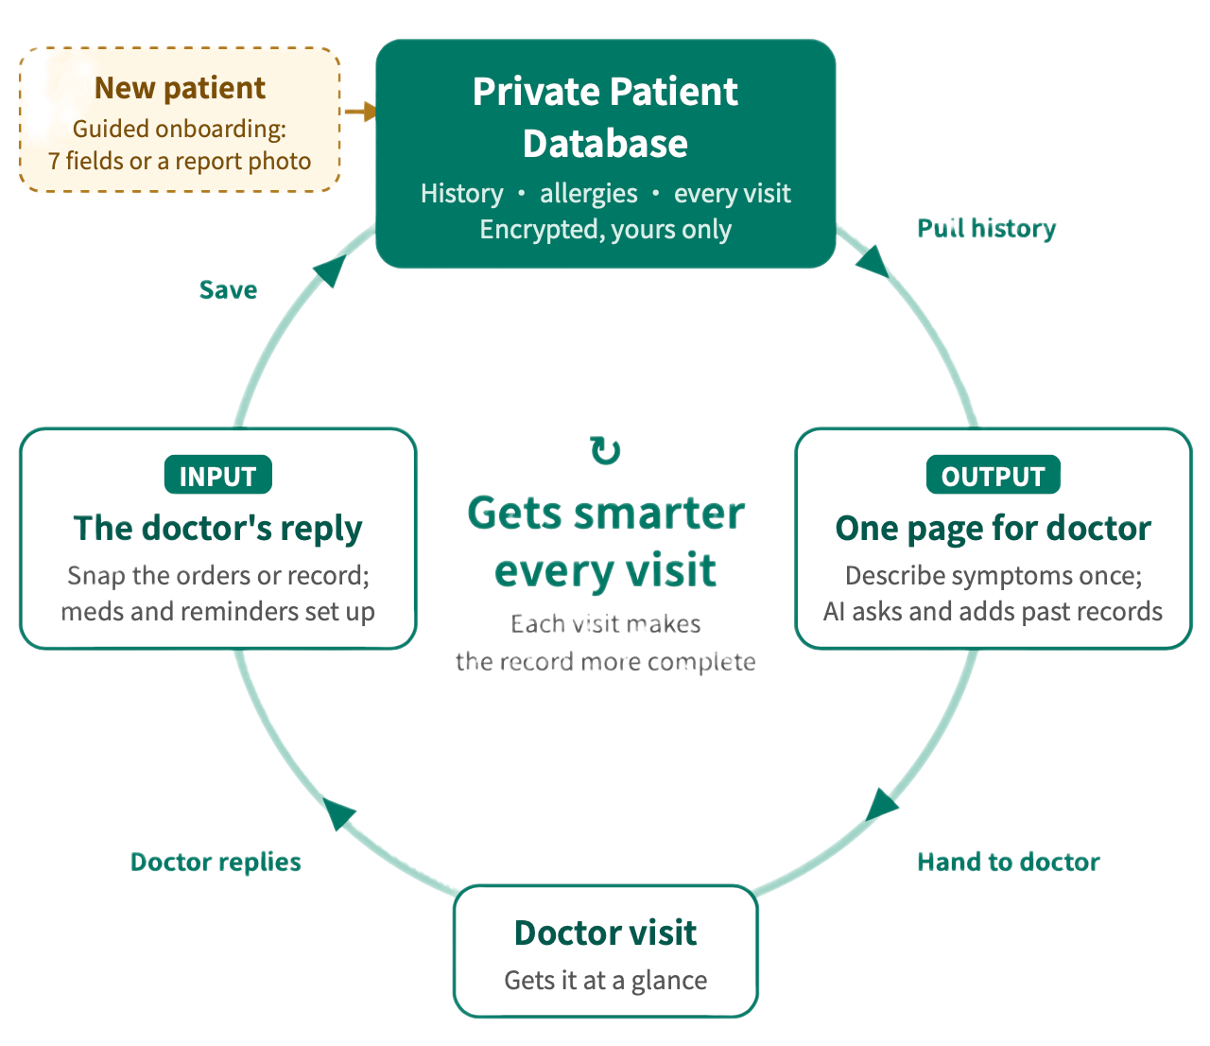

How It Works: The Agentic Workflow
Beyond the Core Visit
Tools that make each visit more informed, safer, and easier to follow.
Before the Visit
Body Map, Plain Language, Red Flags
After the Visit
Follow-Up Tracking, Ask Anything, Visit Timeline, Long-Term Tracking
Always With You
Emergency Card, Bilingual, Tutorial, Health Sync
Notes:
LUCAS · CORE · 40 s
Here is the workflow. Before the doctor: the patient describes the problem by speaking, typing, using a body map or a photo. The model compares three things: the profile, similar past episodes in the record, and what this draft already knows, and it asks one missing item. The patient answers, and the loop repeats until the gaps are filled or the patient says that's all. Then the model writes the page for the doctor. The patient can edit it or regenerate it, and only Save puts it into the record. Rules, not the model, handle danger signals and the urgency and department hint.
The visit has no AI.
After the doctor: the patient chooses whether to link this visit to the earlier record, then records audio or photographs the record. The model reads it with the profile and drafts the Clinical Plan. The patient can ask about any line, and the model explains it from this plan and the profile. The patient ticks which lines become reminders and saves.
On Save, the app writes the memory: the merged record, reminders and explanations. A new long-term medicine changes the profile only after a separate yes. At the next visit, the model reads that saved memory, so questions build on the last plan. Ask at home reads the same memory.
Source: Joanna's written product summary.

Slide 6
Live Demo Time
Notes:
ROBIN · CORE · 5 s intro, then the 3-minute live demo
Let us show you Mr. Lin. He is fictional and his records are preloaded.
DEMO SCRIPT
0:00–0:20 Open /demo/lin. Say he is fictional, 46, with left-knee pain.
0:20–1:00 Before: show his words, one missing-item question, and the doctor page. Point out the similar past episodes the agent found.
1:00–2:10 After: open the visit. Cause under investigation, no new medicine, follow-up in one week. Tap the follow-up line and ask about it.
2:10–2:45 Home: show the reminder to bring records and medicine boxes; ask what to bring and show the answer comes from his record.
2:45–3:00 Point out that his blood-pressure medicine stays unconfirmed.
SETUP: open http://127.0.0.1:3000/demo/lin once before presenting; reopening reseeds the case, so do not refresh. AI responses are in Chinese; narrate in English. Keep a screen recording as backup.

Slide 7
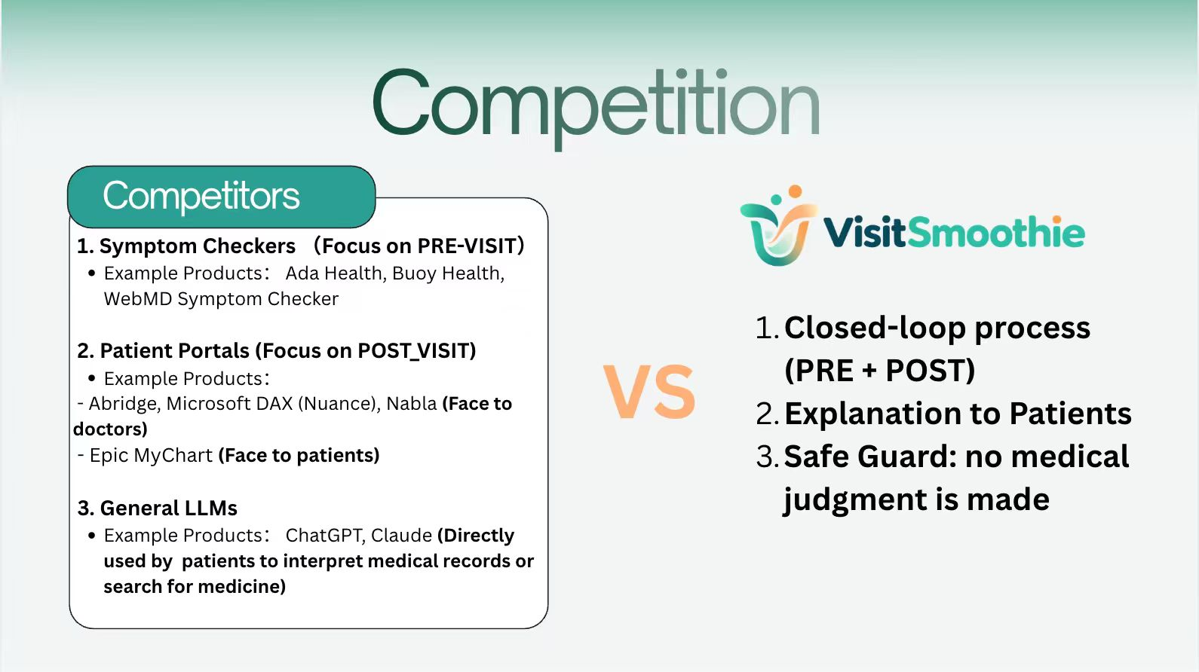



Competitive landscape
Symptom checkers
Ambient AI scribes
Patient portals
General LLMs
Ada Health, Buoy Health, WebMD Symptom Checker
Abridge, Microsoft DAX (Nuance), Nabla
Epic MyChart; post-visit guidance in hospital apps
ChatGPT, Claude, used directly to read records or look up medicines
VisitSmoothie: built for the patient, across one visit: a complete story before it, a plan they can follow after it, and one record that carries into the next.
Notes:
NANCY · OPTIONAL · 40 s (team member's content; wording adjusted for accuracy)
1. Symptom checkers (Ada Health, Buoy Health, WebMD Symptom Checker): they focus on the stage before a diagnosis. Once the patient sees the doctor, their role largely ends. VisitSmoothie also helps before the visit, with follow-up questions and a page for the doctor, and then continues after the consultation.
2. Ambient AI scribes (Abridge, Microsoft DAX, Nabla): very powerful, but built for clinicians and their documentation. Their output is written for doctors, not for a patient trying to follow the plan. VisitSmoothie is for the patient: it turns what they bring home into a plan they can act on.
3. Patient portals (Epic MyChart, hospital apps): they share visit instructions and often let patients message the care team, but answers depend on busy staff and the instructions are not explained line by line. VisitSmoothie lets the patient ask about any line right away, and points questions that need a clinician back to the doctor.
4. General LLMs (ChatGPT, Claude): when patients paste a prescription, a general model answers from general medical knowledge, and its advice may not match what the doctor intended. VisitSmoothie quotes dosage only from the doctor's orders, labels general drug-label content as general, and sends personal reasons back to the doctor.
ACCURACY NOTES for the presenter: (a) MyChart does offer messaging with the care team, so do not say patients cannot ask; (b) do not claim VisitSmoothie lets patients choose an explanation depth unless that feature is in the demo; (c) do not claim it automatically builds a 'next-visit question list' from explanations unless the team confirms it — the doctor page does include questions for the doctor.

Slide 8
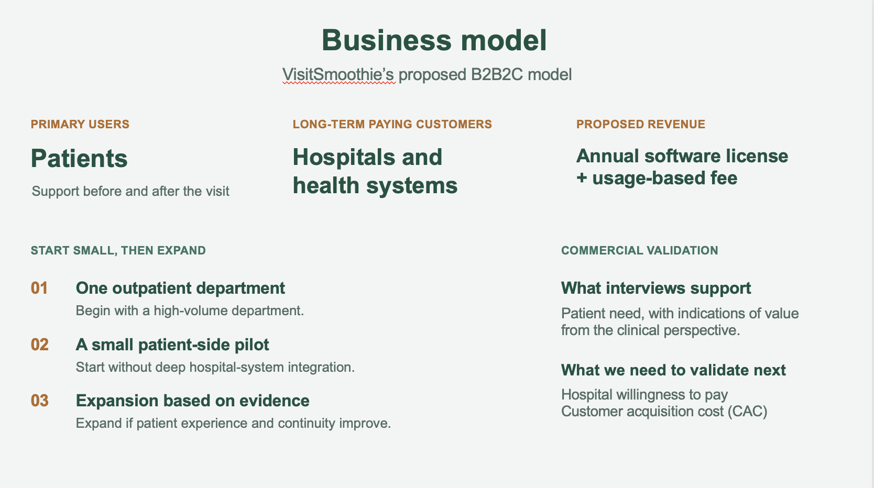
Notes:
Our primary users are patients, but our long-term paying customers are hospitals and health systems. We envision a B2B2C model, where hospitals pay an annual software license plus a usage-based fee to offer VisitSmoothie to their patients.
We would start with one high-volume outpatient department, run a small patient-side pilot without requiring deep hospital-system integration, and then expand if we demonstrate improvements in patient experience and continuity.

Slide 9
Our Team
J
R
N
R
L
Joanna
Ronnie
Nancy
Robin
Lucas
Product lead
Engineer
Engineer
Engineer
Engineer
Notes:
JOANNA · CORE · 20 s
We are Tri Team. I led product; Nancy researched competitors; Ronnie, Robin and Lucas built the product, with Robin on the demo and Lucas on the technology. Three of us interviewed our own families.
Patients cannot always be cured, but they should always be able to tell their story fully and understand what to do next. Make care make sense. Next, we want to test one real before-and-after cycle with a clinician reviewing every output. Thank you.
Q&A (Joanna receives each question and hands off): competition → Nancy; implementation → Lucas, Robin, Ronnie.
- General chatbot? It follows one visit end to end and remembers only what the patient saved.
- Medical advice? No. It organizes the patient's story and explains what the clinician recorded.
- Evidence? Three family interview sets and a working prototype on synthetic data. No clinical or revenue results yet.
- English? Interface partly translated; AI responses and safety rules are Chinese today.
- Data? Synthetic in the demo; Zhipu GLM processes inputs; we keep only text; encrypted at rest.

Slide 10
Notes:
Make Care Make Sense
Make you visit smoother

Slide 11
Appendix 1: interview evidence
Source | What we heard | Product decision
A1 · Joanna’s father, caregiver | Unsure which department to book; hard to get appointments with senior specialists | Record as need; booking out of v1
A2 · Joanna’s mother, chronic condition | Short visits; wants to know why a drug, for how long, what risks; already asks AI | Tap any line to ask, grounded in the record
B1 · Ronnie’s mother | Hard to ask again after leaving; side-effect worries | Questions saved for clarification
B2 · Ronnie’s father, type 2 diabetes | Writes questions before visits; forgets doses; routines and social life interfere | Doctor summary; reminders and check-ins
C · Nancy’s family | Unclear instructions; nursing view stresses structured history; doubts about pre-visit tools | Short, patient-reviewed summary that never replaces history-taking
Convenience sample from team families in China. Notes and relayed accounts, not verbatim transcripts. Participant count for C to be confirmed.
Notes:
Discussion only. Source: VisitSmoothie / AfterDoc interview report, 3 Oct 2026.

Slide 12
Appendix 2: problem data sources
Figure | Source | Caveat
10.15 billion visits in 2024 | National Health Commission of China, 2024 Statistical Bulletin on Health Development (Dec 2025) | All healthcare institutions, not only outpatient clinics
~3 min consultation, ~40 min wait | Implementation report on a large tertiary hospital in China, JMIR, PMC12396732 (2019–2022 data) | One hospital, not a national average
10–15 min US consultation | Cited in the same report | Secondary citation
≤ 5 min for half the world | Irving et al., BMJ Open 2017, systematic review of 67 countries | Primary care; older data
Notes:
Discussion only.

Slide 13
Appendix 3: how it is built, and what is not ready
Layer | What it does | Built with
Interface | Capture, review, reminders | Next.js and React
Workflow | Routing, episode state, actions | TypeScript rules
Language | Intake, extraction, explanations | GLM API, rule fallback for text
Storage | Isolated accounts, encrypted records | SQLite, AES-256-GCM
Not ready yet
AI responses and safety rules are in Chinese
Reminders work while the app is open
Voice and photo need a configured model key
No clinical, usage or revenue results yet
Notes:
Discussion only. Source: README.md, docs/交接说明.md, src/lib/ai/client.ts, src/lib/server/secure-db.ts.

